Slide 1
Stranger Things in Data:
Anomaly Detection in Sensor Data
by Vaughn Parker

Slide 2
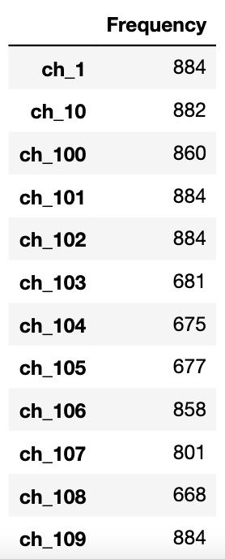
550 channels numbered with integers between 0 and 565
Potentially more channels/sensors in other days
48 channels present in ALL files, likely for measurements that can be found in all machinery (fuel level, temperature, gyroscope)
123 channels present in exactly 9 files, likely that these files were all from the same machine
Perhaps a measuring device rather than a bulldozer
315 FILES have exactly 152 channels

Slide 3
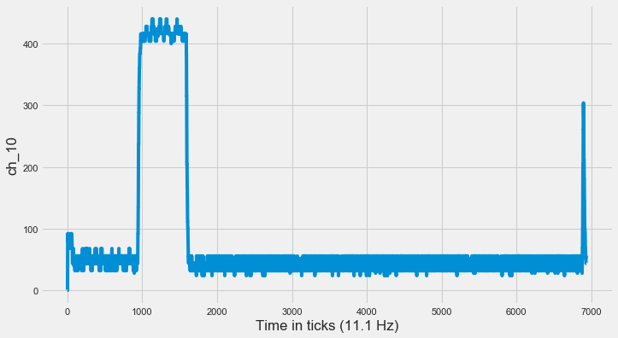
Expected most channels to look like this...

Slide 4
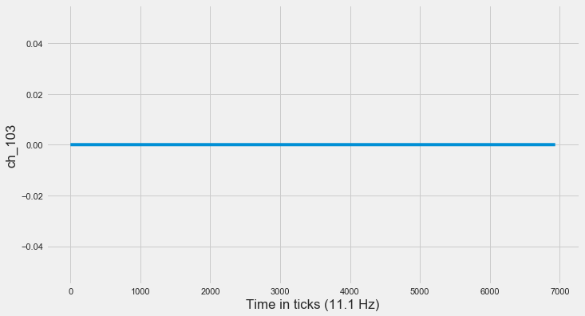
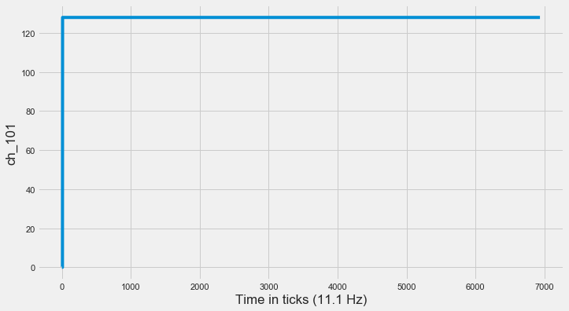
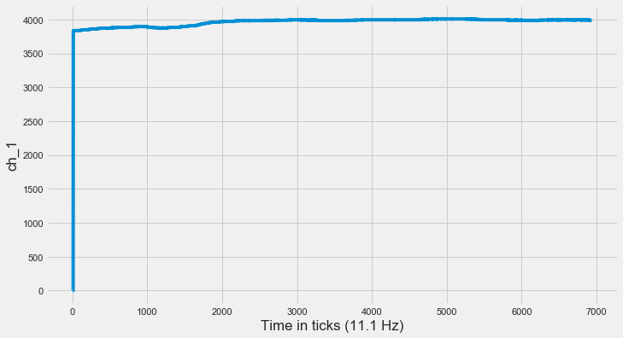
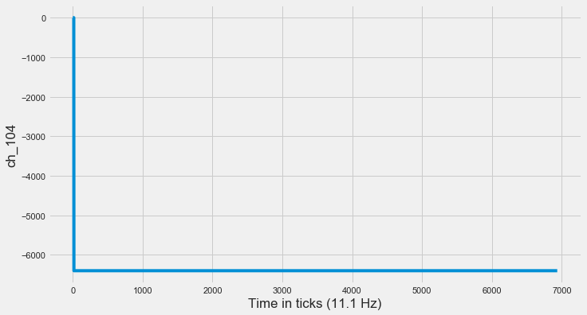
Found most channels looked like this

Slide 5


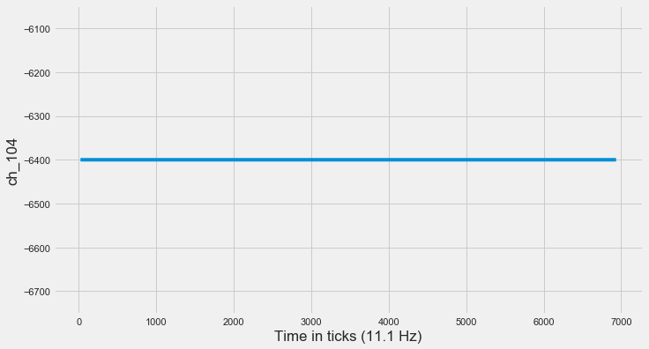
After removing first 2 seconds (22 rows in this case)

Slide 6
After sampling 100 random files, we see that on average, 46.4% of all channels in a file flatline at one value (ignoring the first 2 seconds)
After removing first 2 seconds (22 rows in this case)

Slide 7
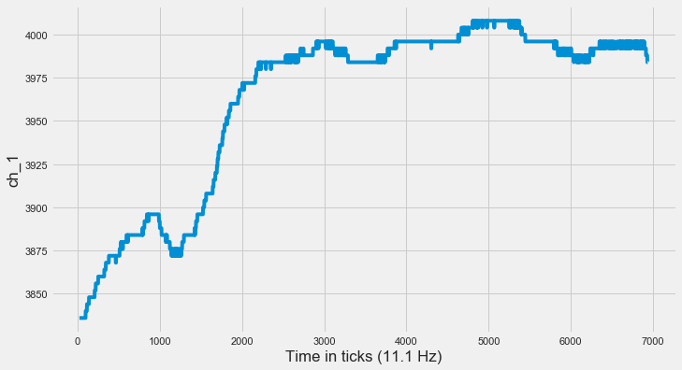
After removing first 2 seconds (22 rows in this case)

Slide 8
Zoom in on the data after the 2 second mark

Slide 9
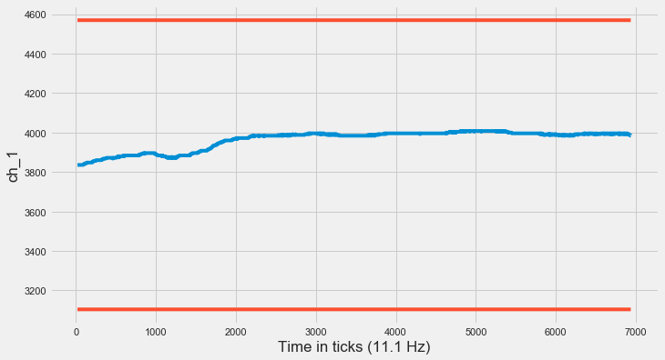

Slide 10
Measurements always stay within +2σ and -2σ of mean

Slide 11
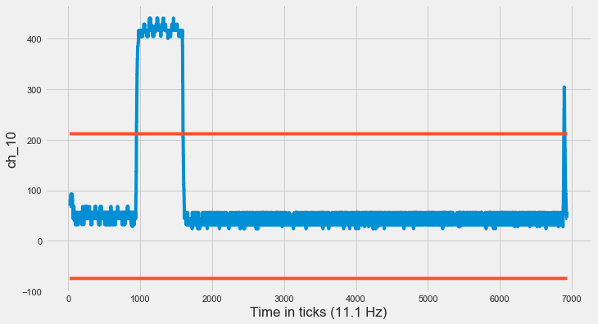

Slide 13
Test isn’t perfect. Sometimes data is valid but goes outside of range

Slide 14
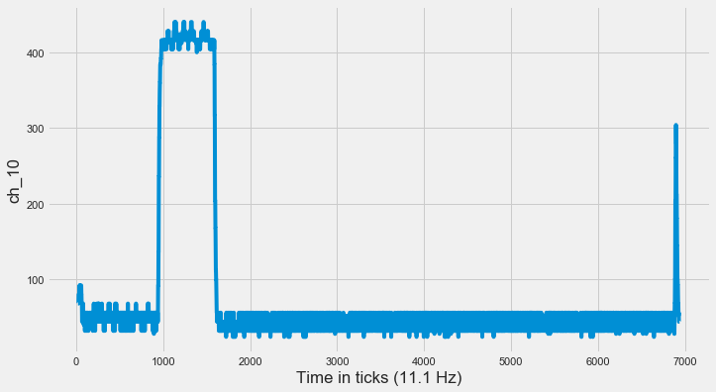
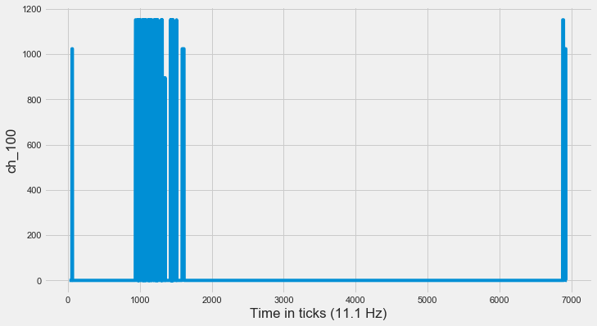

Slide 15
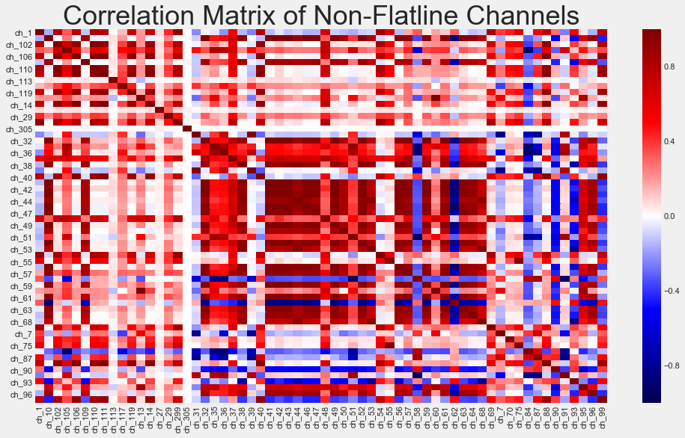

Slide 18
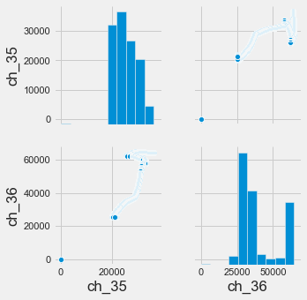

Slide 20
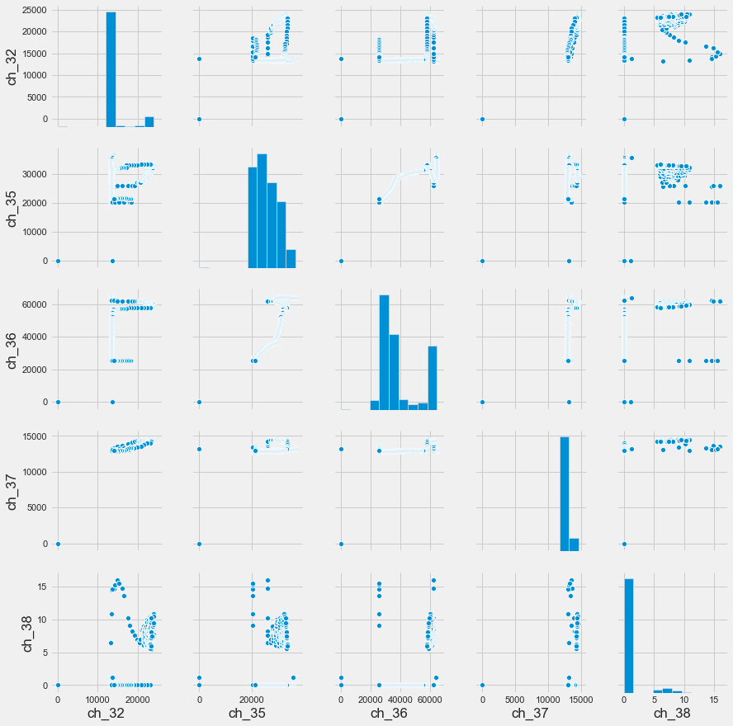

Slide 21
